Slide 1
Meteor Crater LWA Station
Sara Jones
Arizona State University

Slide 2
Table of contents
01
02
03
05
Objectives
Design
My Role
Status

Slide 3
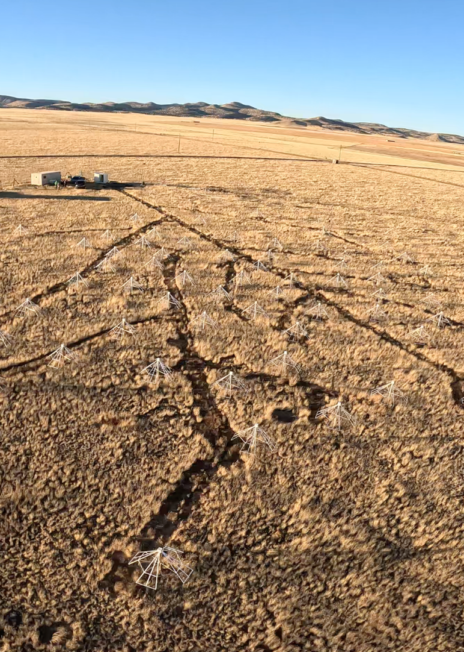
Objectives
Long Wavelength Array (LWA)
Radio Telescope- Interferometric Array
LWA Swarm

Slide 4
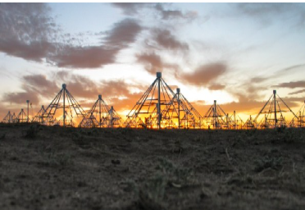
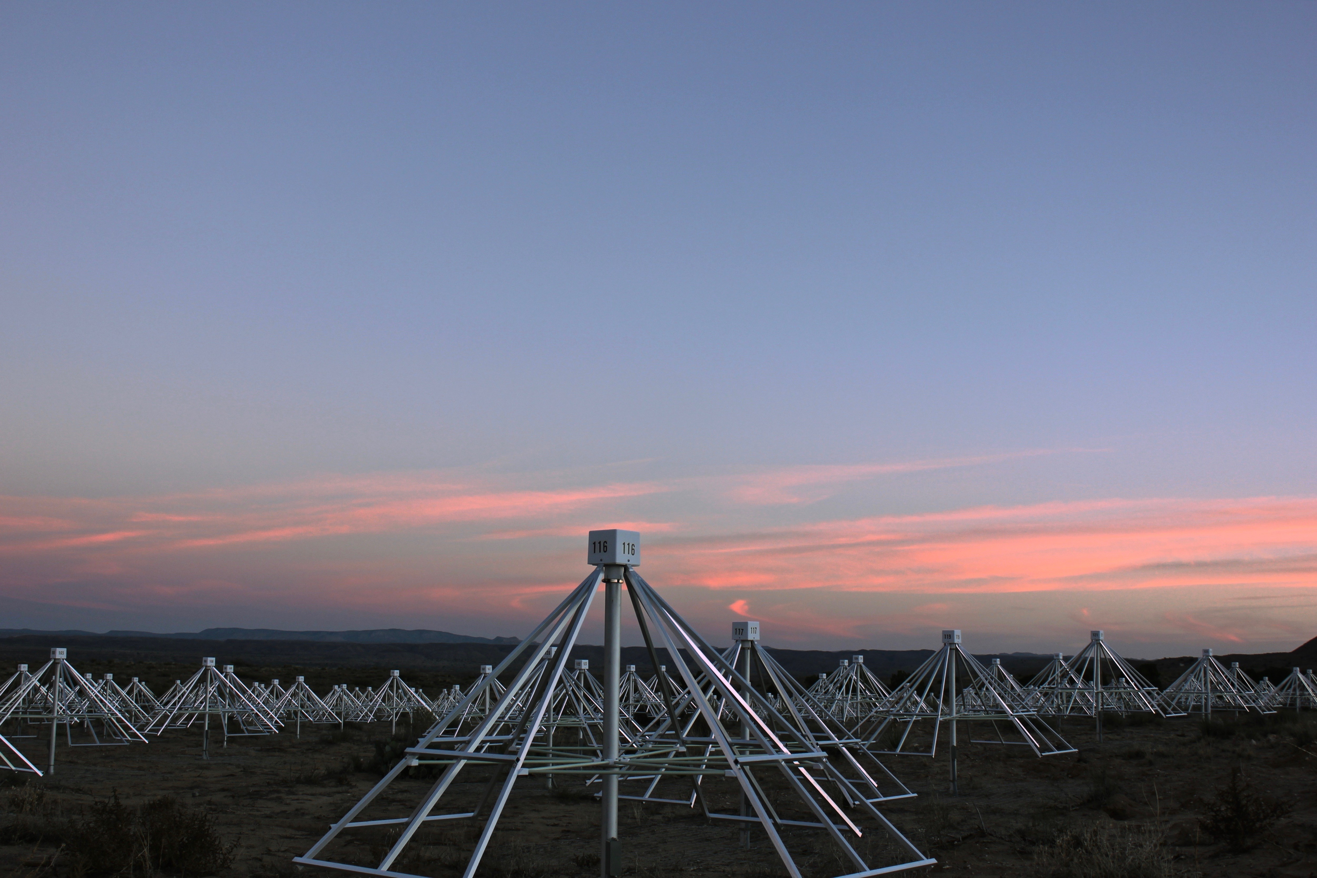
Science Goals

Slide 5
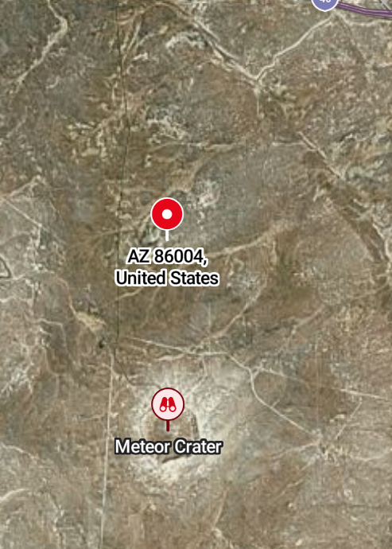
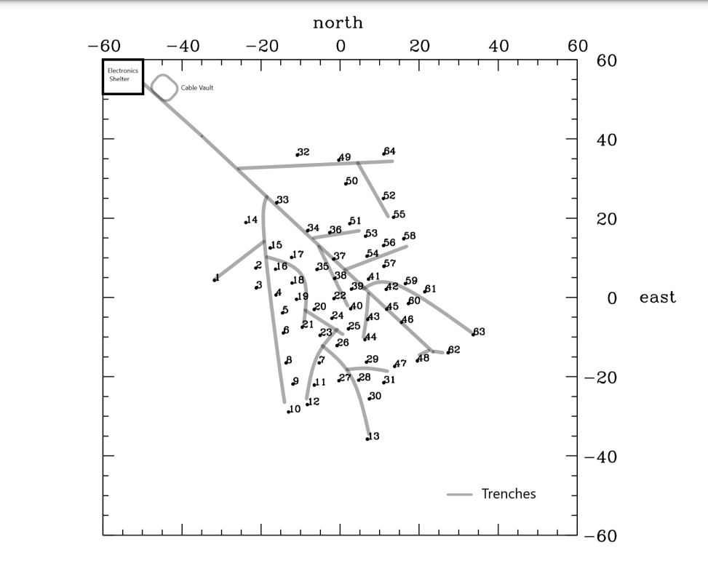
Design
Winslow, AZ
64 antennas with 256 dipoles
10-88 MHz

Slide 6
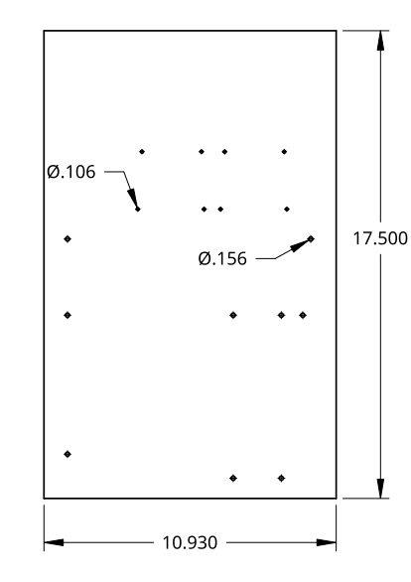
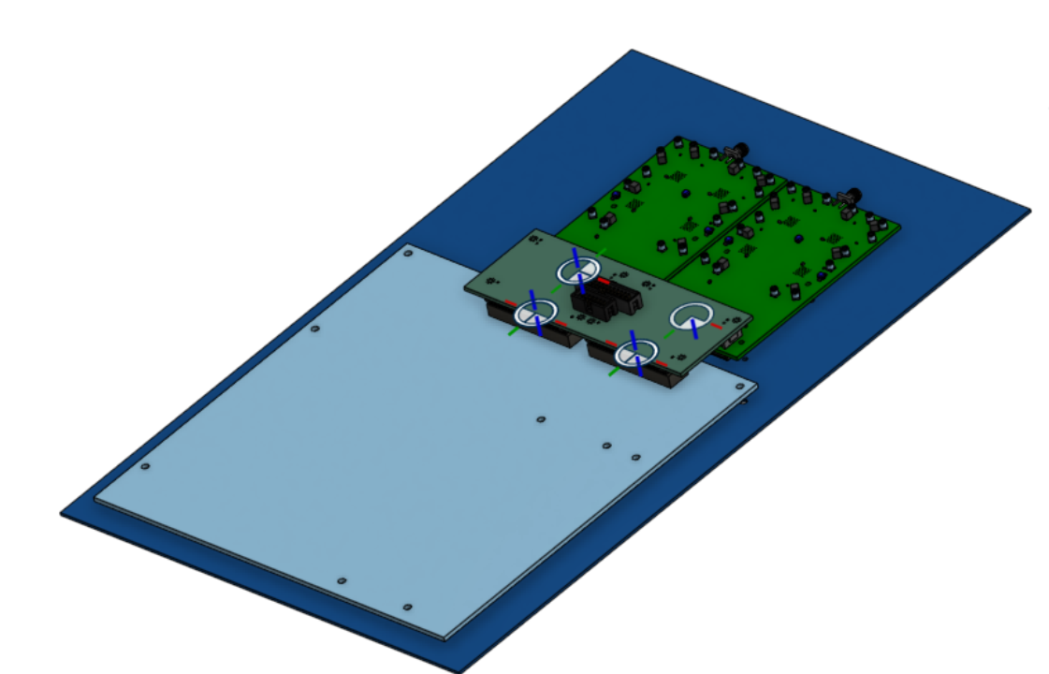
My Role
Custom Digital Rack
Optimized efficiency and greater bandwidth

Slide 7
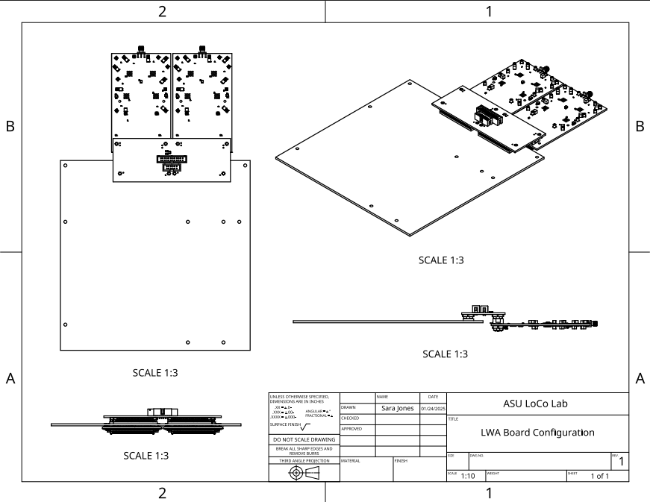

Slide 8
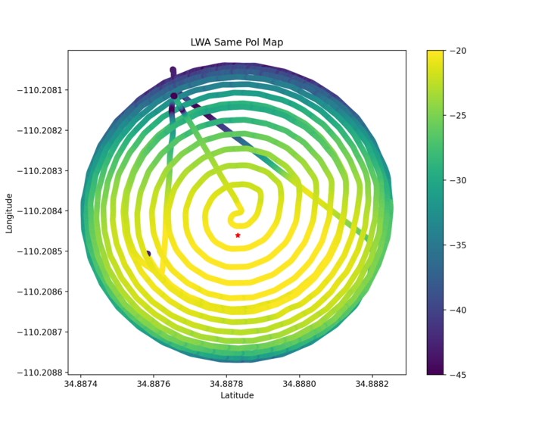
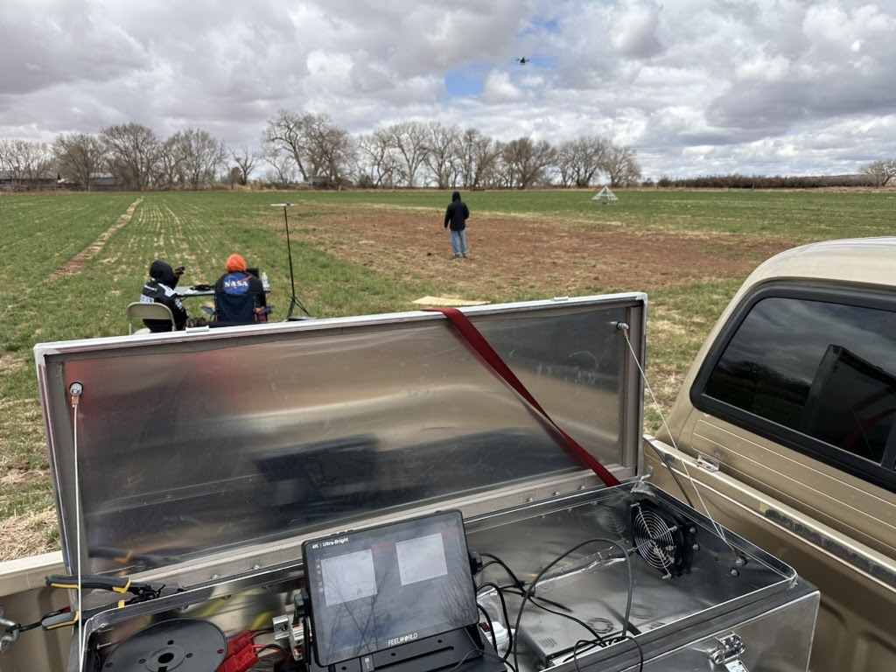
Site Trip
Drone beam mapping
Calibration

Slide 9
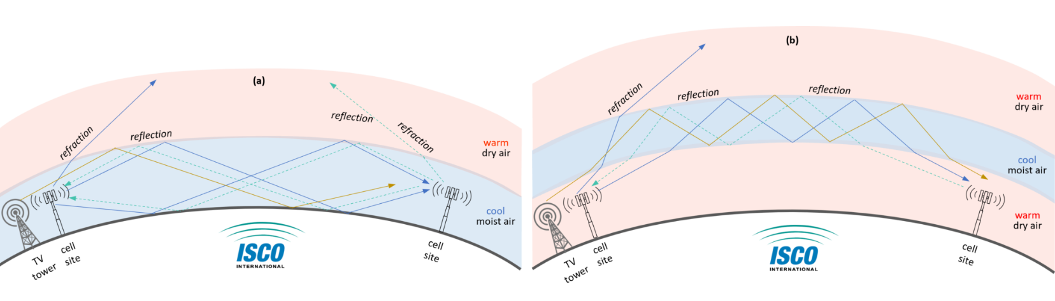
Tropospheric Ducting
Transient propagation effect occurring in the lowest layer of Earth’s atmosphere
Ducting occurs when temperature inversions form over large bodies of water or widespread open spaces

Slide 10
Next Steps

Slide 11
References
[1] Taylor et al., 2020, LWA Memo Series 210, https://leo.phys.unm.edu/~lwa/memos/memo/lwa0210a.pdf
[2] Taylor et al., 2023, LWA Memo Series 226, https://leo.phys.unm.edu/~lwa/memos/memo/lwa0226.pdf
[3] The Long Wavelength Array. Long Wavelength Array. (n.d.). https://leo.phys.unm.edu/~lwa/index.html
[4] Isco. (2022, April 25). What is tropospheric ducting?. ISCO. https://iscointl.com/what-is-tropospheric-ducting/

Slide 12


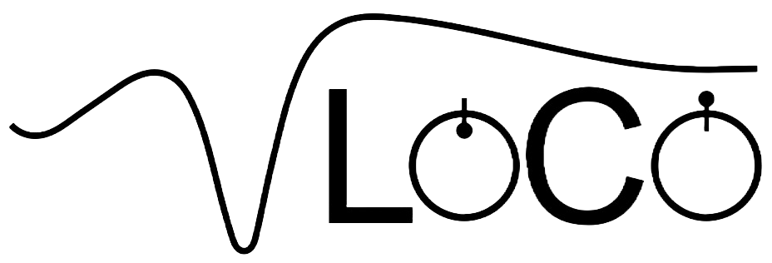



Thanks!
Do you have any questions?
sejone37@asu.edu
480-828-5504
https://loco.lab.asu.edu/

